Slide 1
ARTIFICIAL INTELLIGENCE FROM THE POINT OF VIEW OF LAW: TO REGULATE OR NOT TO INTERFERE?
Lidia Mikheeva
Russia
Head of the Russian Private Law Research Center

Slide 2
THE LEGAL NATURE OF ARTIFICIAL INTELLIGENCE
The artificial intelligence is a system of algorithms.
It is primarily a product of human creativity.
It is a subject of intellectual property. Therefore, this product of creative work has an author and a subsequent copyright holder.

Slide 3
THE ISSUE OF COMPENSATION FOR THE DAMAGE
1) It is necessary to establish who created this object, who bought it, who gave it the command that led to a damaging result.
2) If the contracts, on the basis of which one of the listed persons acted, did not exempt him from liability, then all those listed above will be responsible for causing damage.
The rule: Only the agreement between the user of the program and the owner of the program (and the agreement between the owner of the program and the author) can release the owner of the program (or the author) from liability for damage to third persons.

Slide 4
WHO OWNS THE RIGHTS TO THE RESULT OF AI USING?
This issue requires clarity. Clarity is also needed because secondary and subsequent products will be created on the basis of artificial intelligence products.
The contract between the owner of the rights to the program and the user of the program determines who will own the result.

Slide 5
IMPORTANT PRINCIPLES
The autonomous will
The freedom of contract
This gives us the opportunity to avoid driving progress into a tough framework, allowing for its development.

Slide 6
THE RULE OF NON-INTERFERENCE
Free will of market participants shall be the very regulator of artificial intelligence, which will provide necessary and sufficient restrictions to prevent the use of artificial intelligence for evil purposes.
Because:
A consistent series of contracts concluded between all the listed persons distributes the risk of liability for damage between them and resolves the problem of rights to the result.

Slide 7
RULES APPLICABLE IF THE PREVIOUS RULE CANNOT BE APPLIED
If the issues are not settled by the contract, then a backup rules should be applied:
The right to the result should be recognized for the user, since open access to AI implies the possibility for the user to become the owner of the result.
By default, the user must be responsible for the damage caused as a result of using the AI, having the opportunity to make a recourse claim against the person from whom the right to use the AI was acquired.
Ultimately, a recourse claim can be made against the author of the algorithm, because it was in his power to prevent all, including unforeseen, cases of damage.

Slide 8
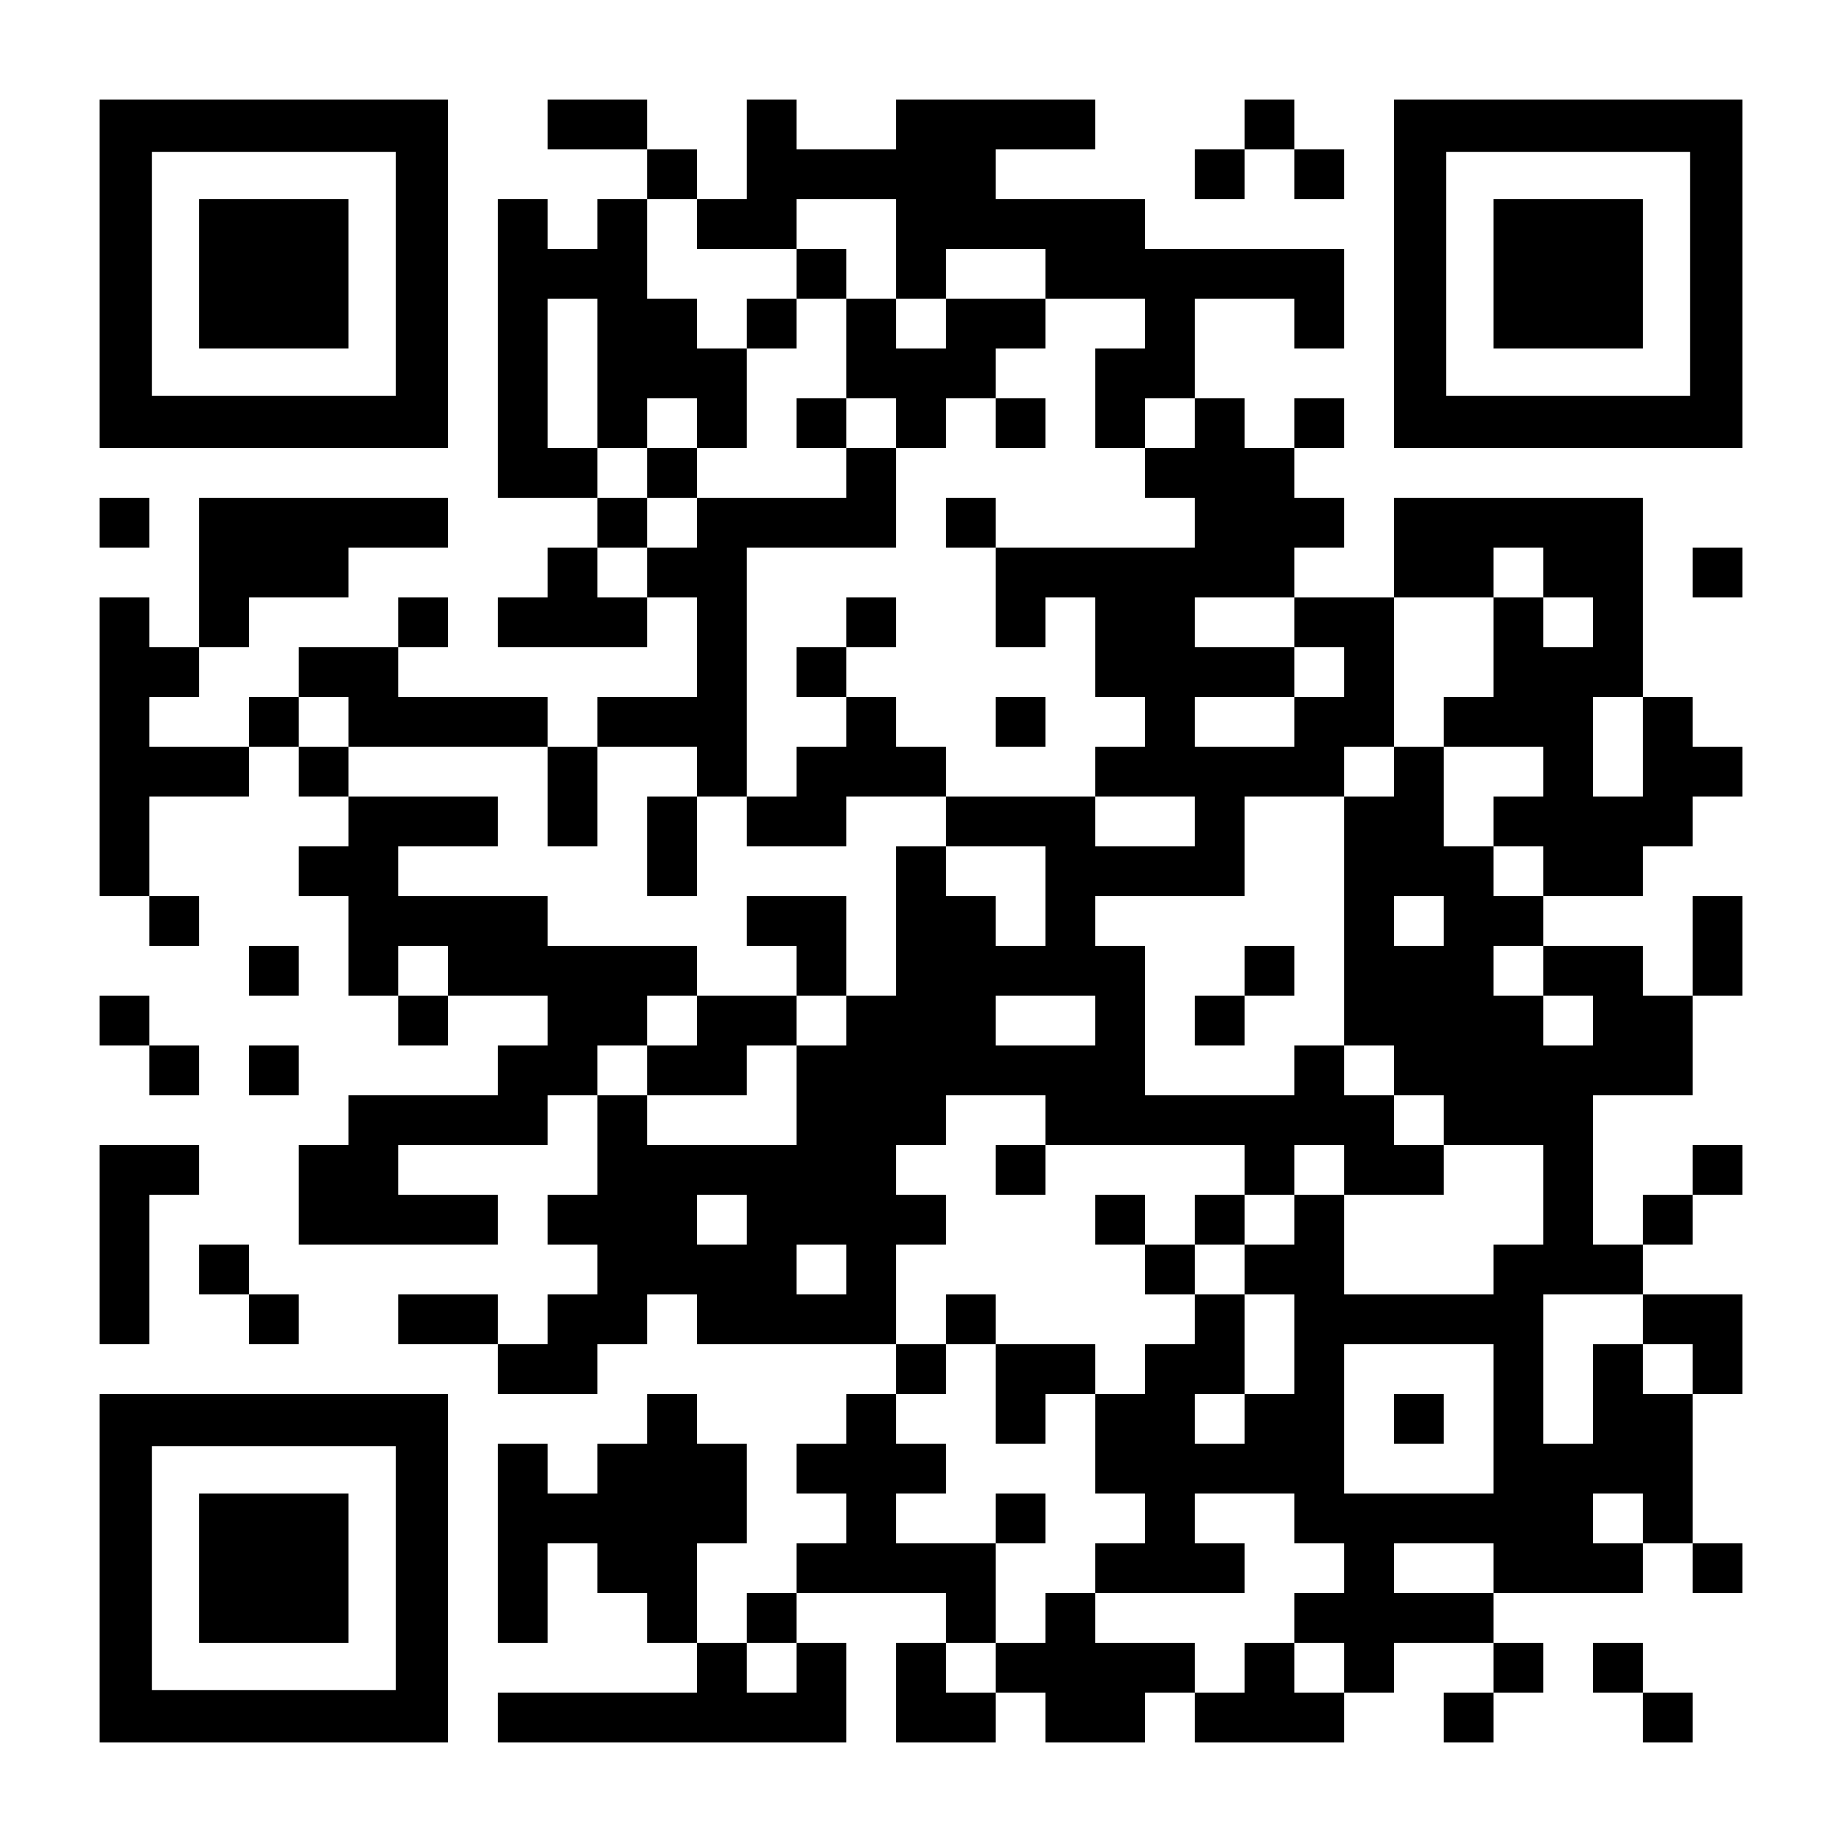
THANK YOU!
Lidia Mikheeva
Doctor of Law, PhD in Law, Professor, Honorary Lawyer of the Russian Federation
Head of the Russian Private Law Research Center
www.privlaw.ru
mikheeva@privlaw.ru

